Slide 1
LAUKI FINANCE
Lauki Finance: Credit Risk Predictive Modeling & Performance Insights
Presenting an overview of dataset structure, model evaluation, and strategic recommendations.

Slide 2
Project Objective & Success Criteria
LAUKI FINANCE
Target Performance Metrics
Core Objective
Credit Risk Predictive Model
Build a robust predictive model for the risk assessment unit to measure and evaluate credit risk accurately.
Strategic Impact
Empowers the risk unit with data-driven precision to optimize credit decisions and minimize default exposure.
Discrimination Power
> 85%
Area Under the Curve (AUC) and Gini Coefficient
Separation Capacity
> 40%
Kolmogorov-Smirnov (KS) Statistic
Early Decile Risk Capture
Maximum KS Statistic must occur within the first 3 deciles to prove strong discriminative power for high-risk applicants.
Business Explainability
High model interpretability to extract business rules.

Slide 3

Train and Test Dataset Structure
LAUKI FINANCE
Data Source
Historical loan data spanning the past two years from Lauki Finance
Timeline Split (Out-of-Time Testing)
Training & Validation Set
Feb 2022 – Feb 2024
Data used for building and tuning the model over a 2-year historical window.
Out-of-Time (OOT) Test
Mar 2024 – May 2024
Out-of-Time test data used to evaluate real-world generalization on unseen future periods.

Slide 4
Feature Overview
LAUKI FINANCE
DATA SEGMENT 01
Customer Demographics
DATA SEGMENT 02
Bureau Data
cust_id
cust_id
age
no_of_open_accounts &
no_of_closed_accounts
gender & marital_status
employment_status
total_loan_months &
delinquent_months
income
number_of_dependants
total_dpd
residence_type &
years_at_current_address
enquiry_count
credit_utilization_ratio
city, state, zipcode

Slide 5
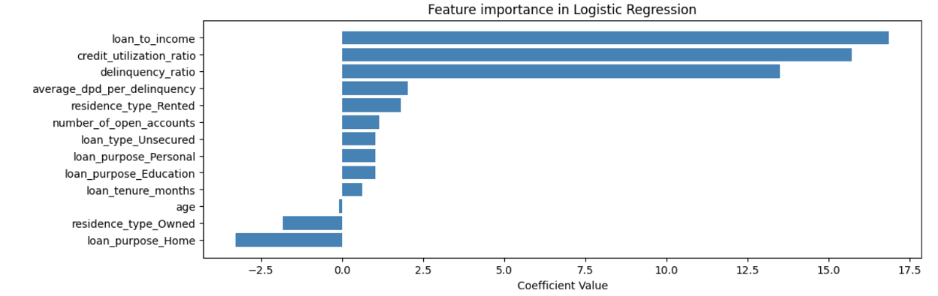
Significant Variables & Information Value
Key predictors ranked by Information Value (IV) & Logistic Regression Feature Importance
LAUKI FINANCE
Information Value (IV) Rankings
Logistic Regression Feature Importance
Predictor Variable | IV Score
credit_utilization_ratio | 2.35
delinquency_ratio | 0.71
loan_to_income | 0.47
avg_dpd_per_delinquency | 0.40
loan_purpose | 0.36
residence_type | 0.24
loan_tenure_months | 0.21
loan_type | 0.16
age | 0.08
number_of_open_accounts | 0.08
Key Insights
• Top Predictor: credit_utilization_ratio exhibits overwhelmingly strong predictive power (IV: 2.35).
• Positive Drivers: Higher loan-to-income and delinquency ratios strongly drive default risk in the logistic regression model.

Slide 6
Modeling Workflow Steps
LAUKI FINANCE
STEP 01
STEP 02
STEP 03
STEP 04
STEP 05
STEP 06
Dataset Integration
Merging critical data sources:
• Internal customer records
• Loan details
• External credit bureau data
Target Variable
Binary classification indicator ('default'):
• 0: Good credit
• 1: Bad credit
Data Preprocessing
• Cleaning typos
• Imputing missing categorical values
• Feature selection via IV, VIF & domain rules
• Min-Max scaling
Train-Test Split
Data partition ratio:
• 75% Training
• 25% Testing
Algorithm & Tuning
Exploration:
• Logistic Regression
• XGBoost
• Random Forest
Optimization:
• RandomizedSearchCV
• Optuna
Evaluation Metrics
Performance assessment:
• AUC
• KS Statistic
• Gini Coefficient
• Classification Reports
END-TO-END CREDIT RISK MODELING PIPELINE • ARCHITECTURE OVERVIEW

Slide 7
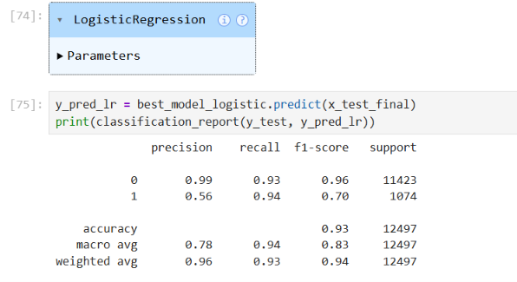
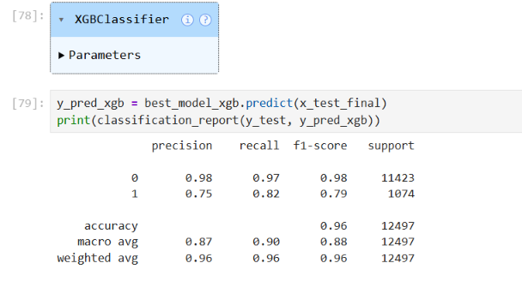
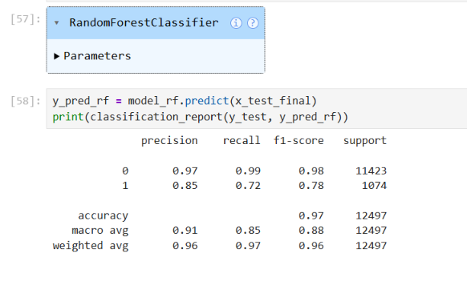
Algorithm Exploration & Comparison
LAUKI FINANCE
LOGISTIC REGRESSION (FAVORED)
XGBOOST CLASSIFIER
RANDOM FOREST CLASSIFIER
PRODUCTION SELECTION & EXECUTIVE TAKEAWAYS
Logistic Regression is selected for production deployment over higher raw AUC models.
• Higher Raw Performance Context: While XGBoost yields a slightly higher raw AUC, the gain is marginal compared to the interpretability trade-off in credit risk.
• Superior Transparency & Governance: Logistic Regression provides full coefficient extractability, facilitating regulatory compliance and auditability.
• Business Engine Alignment: Seamless integration with existing business rule engines and adverse action scorecards.

Slide 8
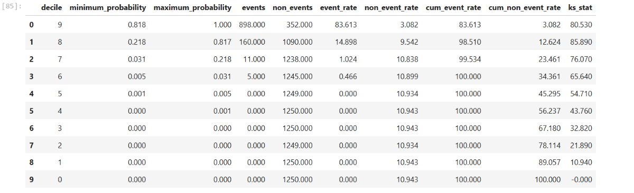
Model Evaluation & Decile Breakdown
Credit Risk Rank-Ordering Analysis & Cutoff Optimization
LAUKI FINANCE
MAXIMUM SEPARATION POWER
85.9% Max KS Statistic achieved at Decile 8
Demonstrates exceptional separation between defaulters and non-defaulters.
DECILE 9 (HIGHEST RISK) KS: 80.5%
Min Prob: 0.81 | Event Rate: 72% | Cum Event Rate: 83.8%
KEY BUSINESS TAKEAWAY
98.6% Default Capture Rate
Targeting the top 2 deciles (Deciles 9 & 8) successfully captures approximately 98.6% of all actual defaulters, enabling highly concentrated risk mitigation.
DECILE 8 (MAX KS PEAK) KS: 85.9%
Min Prob: 0.20 | Event Rate: 12.7% | Cum Event Rate: 98.6%
OPERATIONAL RECOMMENDATION
Optimal Probability Cutoff
Setting a probability threshold at 0.218 (Decile 8 cutoff) optimizes automated screening, balancing risk exposure and decisioning automation.
DECILE 7 KS: 76.1%
Min Prob: 0.03 | Event Rate: 0.8% | Cum Event Rate: 99.5%

Slide 9
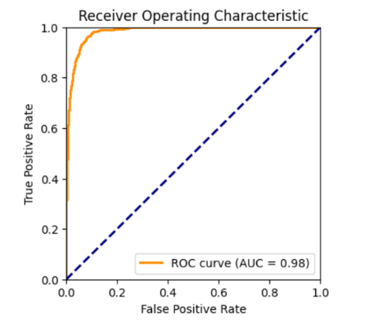
Summary Metrics & ROC Curve
LAUKI FINANCE
Final Model AUC
98%
Final Model Gini Coefficient
96%
Top 3 Deciles Default Capture Rate
99.53%
Effectively capturing nearly all bad loans before manual intervention.

Slide 10
Strategic Recommendations & Growth Opportunities
LAUKI FINANCE
CORE RECOMMENDATIONS
EXECUTIVE CLOSING
Model Threshold Tuning
Optimize cut-off points to balance risk acceptance with growth targets and dynamic portfolio performance.
INTERACTIVE DISCUSSION
Open Floor for Q&A
Addressing stakeholder questions regarding critical decision drivers and operational readiness:
Threshold tuning and calibration
Operational integration timelines
Compliance rules and governance frameworks
Operational Integration
Embed automated scoring seamlessly into existing credit decision workflows and infrastructure.
Compliance & Governance
Enforce strict adherence to regulatory rules, fair lending requirements, and model governance standards.

